Slide 1
Recitation 7
Greg, Will, Sheil

Slide 2
Agenda
Soldering Demo
Arduino IDE
Arduino Programming

Slide 3
Soldering Demo with Greg

Slide 4
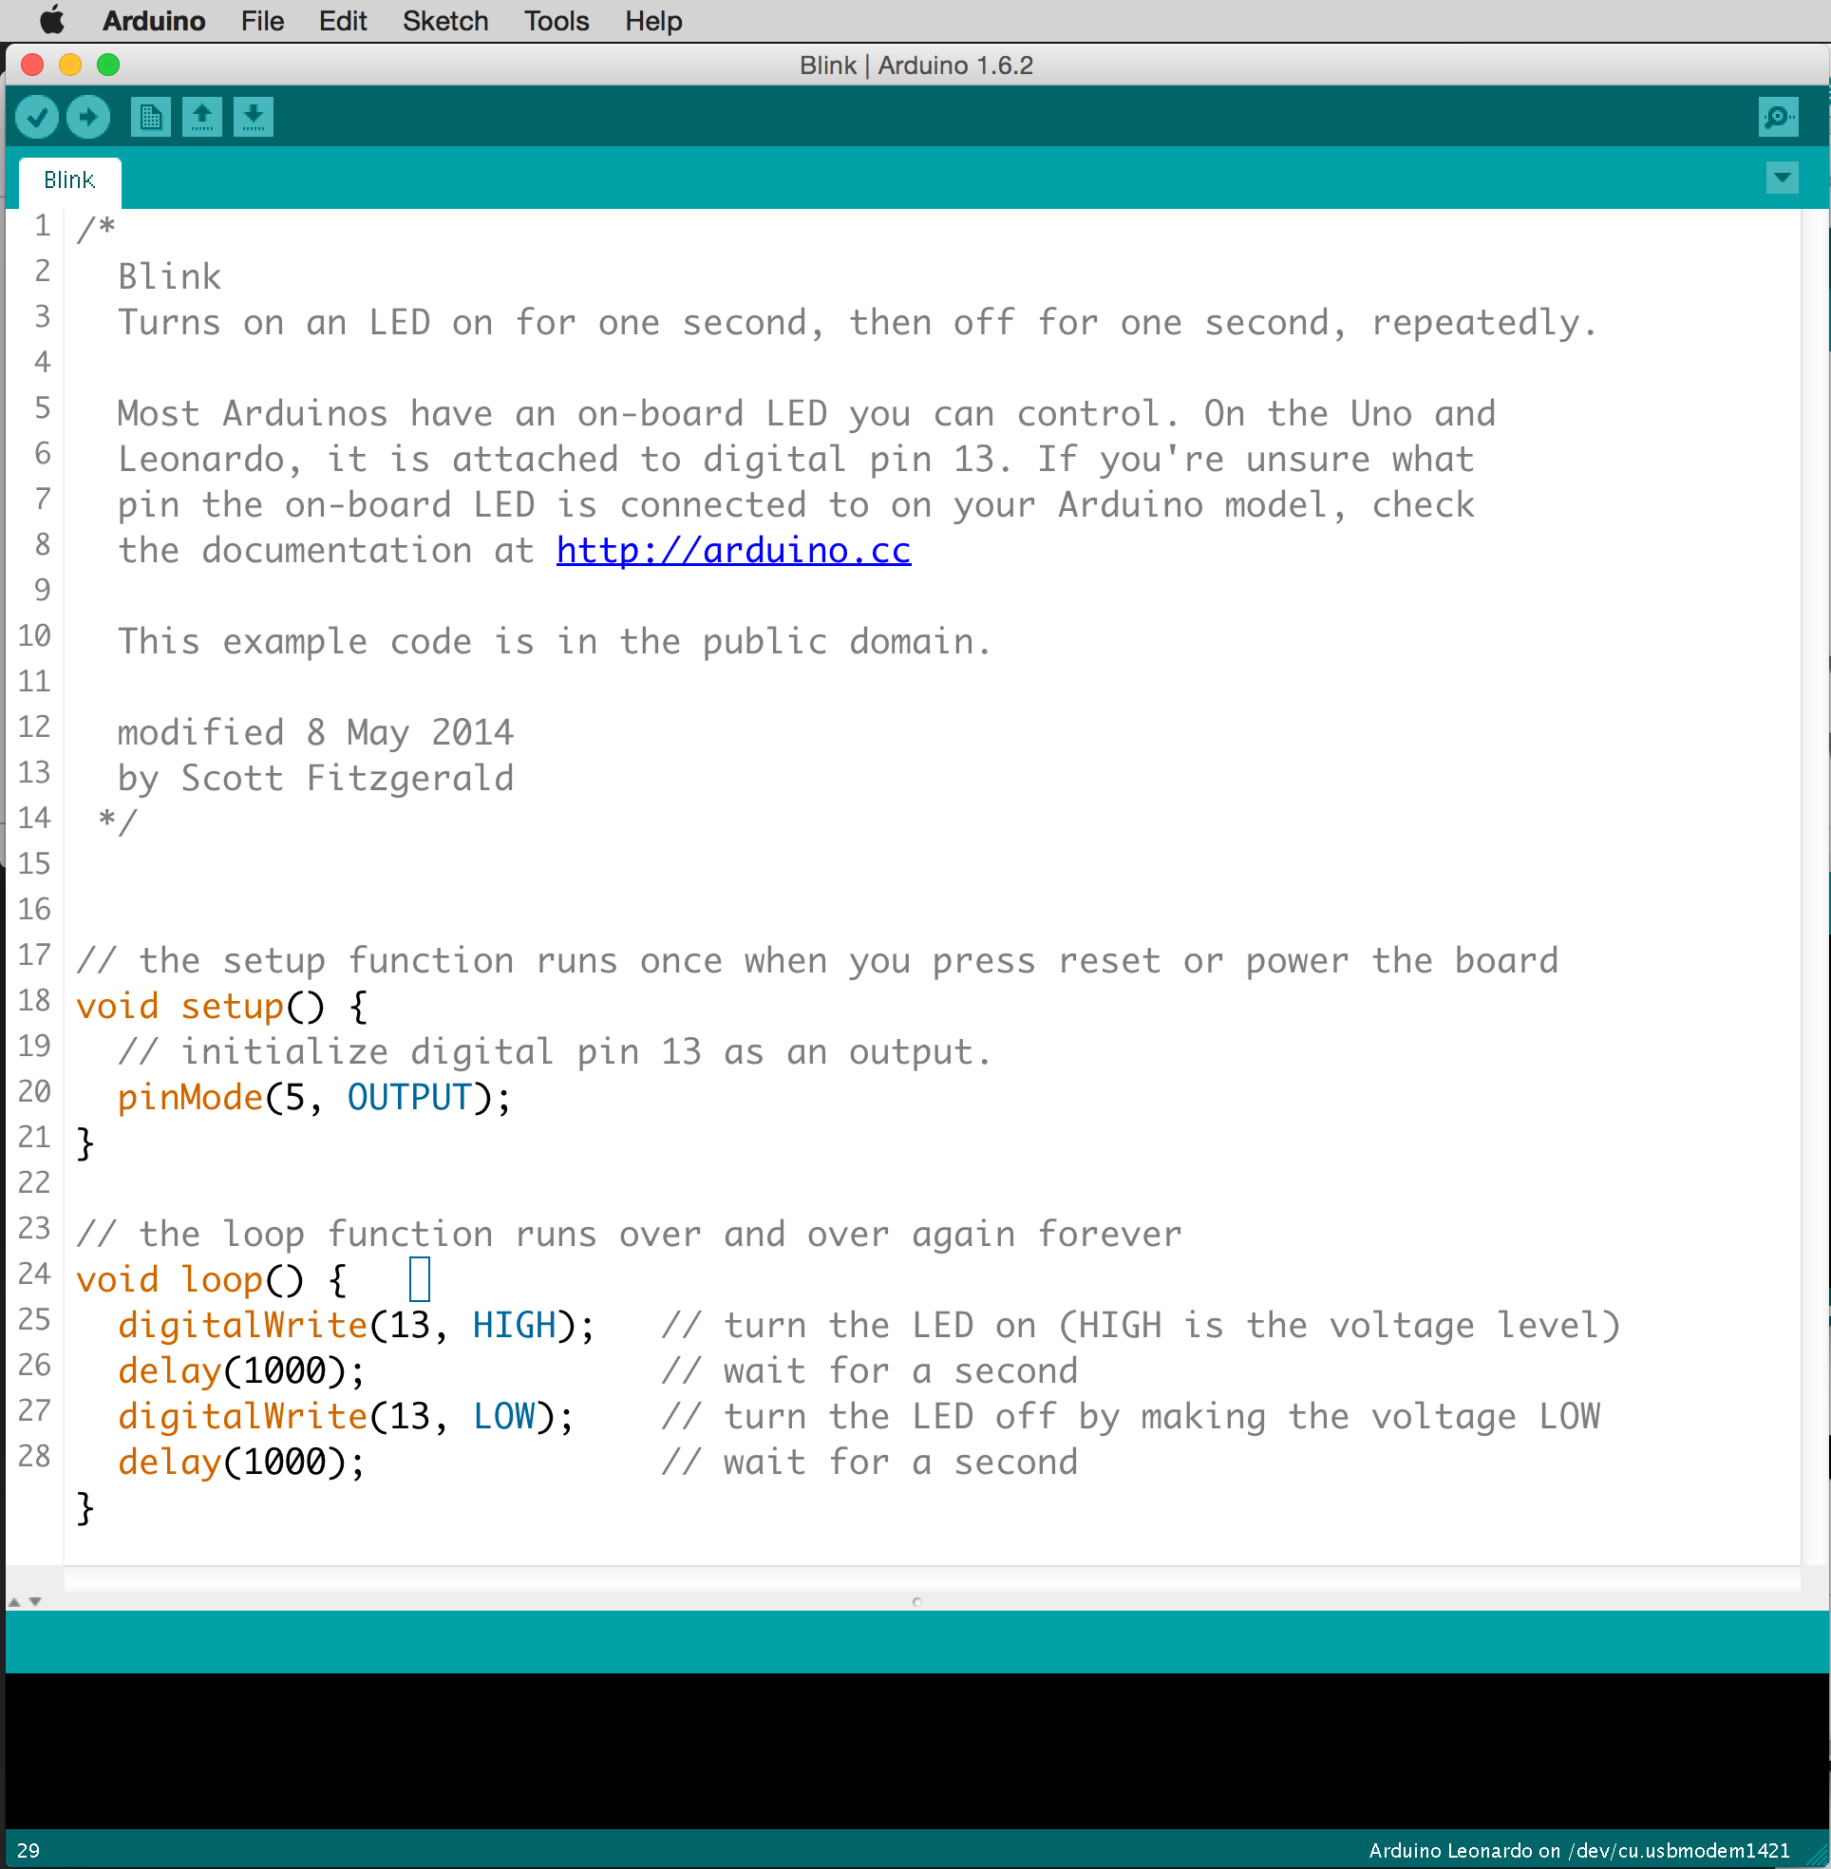
Arduino Integrated Development Environment
Install according to instructions on http://medesign.seas.upenn.edu/index.php/Guides/ESP32
Install ESP32 Pico via Arduino board manager: https://github.com/espressif/arduino-esp32#installation-instructions

Slide 5
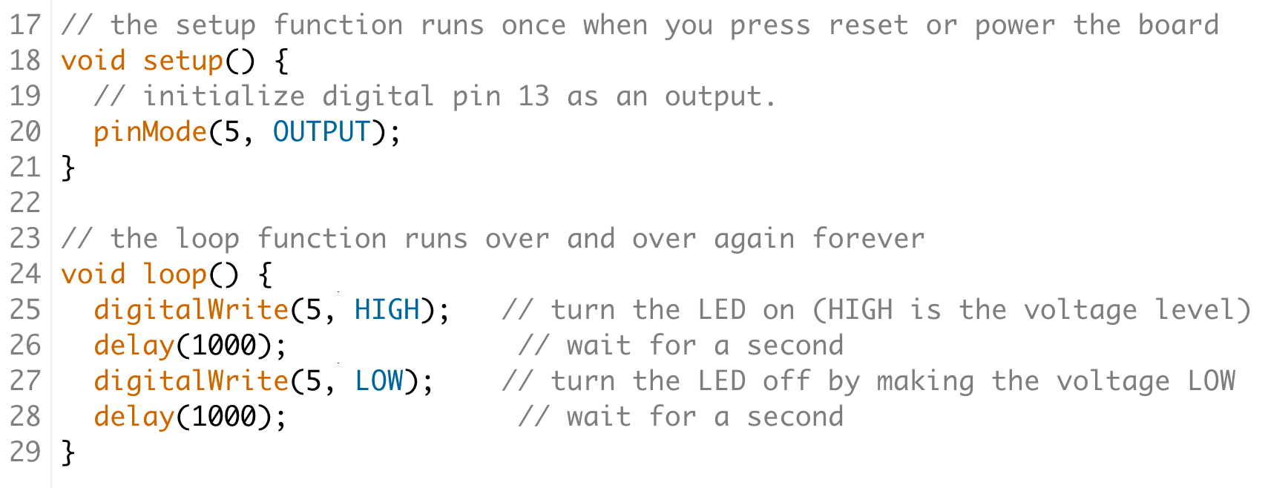
Structure of an Arduino Program / Sketch
Setup runs one time
Loop runs forever

Slide 6
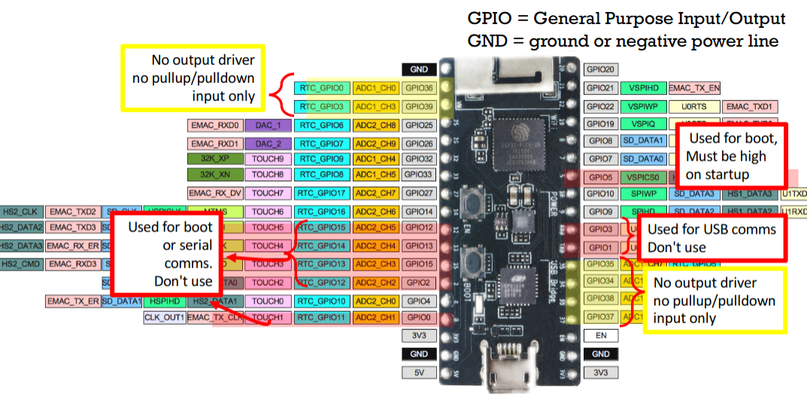
Resources on Programming ESP32s
Arduino language (a more basic version of C++, very similar to C)
http://medesign.seas.upenn.edu/index.php/Guides/ESP32-pins
ledc function definitions
Demo: ledc example code on Canvas
Files > Resources > ESP32 Arduino Lecture Examples
A bunch of other handy examples

Slide 7
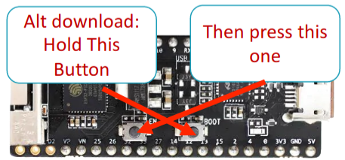
ESP32 Upload Troubleshooting
Check port
Check that correct board is selected: “ESP 32 Pico Kit”
Press the reset button on the board
Try a different USB cable
Try a different ESP32
Note: Beware of Electro-Static Discharge damaging IO pins

